Slide 1
Public health response at the small community scale
Sarah Coefield, Air Quality Specialist
Missoula City-County Health Department
Wildfire Smoke: A Growing Threat to Air Quality and Public Health
BC Lung Association; Vancouver, BC; February 6, 2019

Slide 2
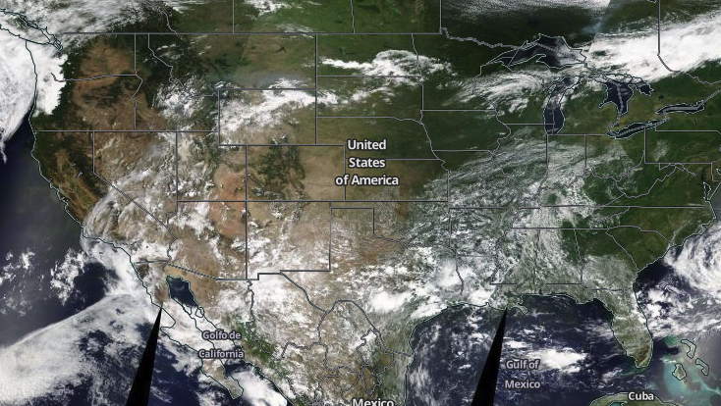
Missoula

Slide 3
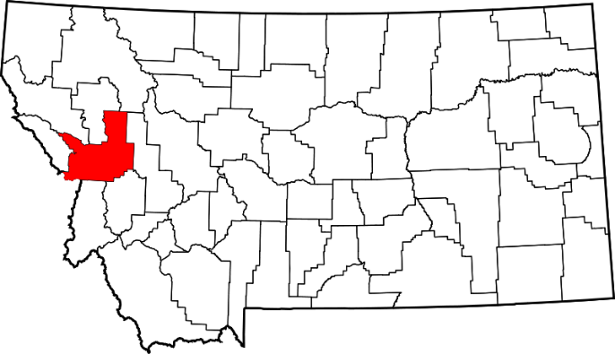
Missoula County
~117,000 Residents | 2,618 mi² | 2 Air Quality Specialists

Slide 4
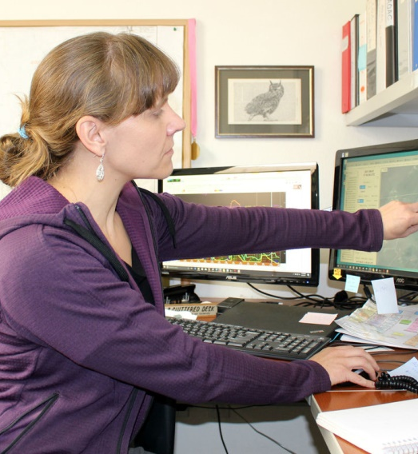
Air quality specialist tasks during wildfire season:
Monitor air quality
Provide health advisories to the public
Collect snazzy smoke photos
And also do everything else the job normally requires (divide and conquer)
As of 2017: Coordinate the county’s public health response to wildfire smoke

Slide 5
Missoula County’s public health response to wildfire smoke
Communication
Planning/Policy
Interventions
Air quality monitoring
Outreach
Studies
Community Needs Assessment

Slide 6
Wildfire Public Health Strategies
Traditional
New Direction
Monitor air quality
Issue health advisories
Emphasize reducing activity levels and staying inside
Monitor air quality
Issue health advisories
Emphasize reducing activity levels and staying inside with filtered air
Create clean air spaces
Direct interventions
Policy/Institutional controls

Slide 7
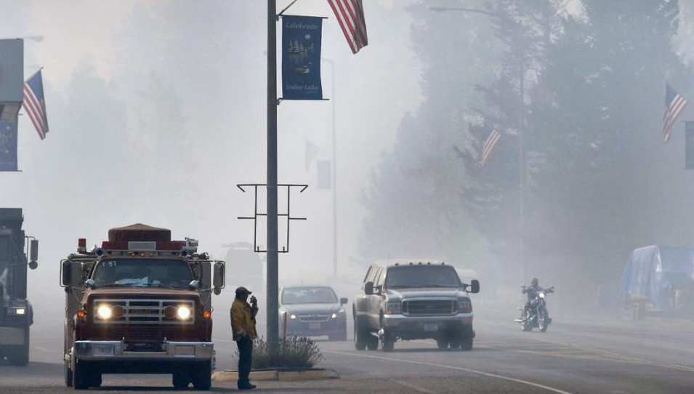
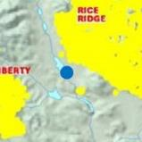
Seeley Lake
35 mornings of hazardous air quality in 2017
Photo credit: Kurt Wilson, Missoulian

Slide 8
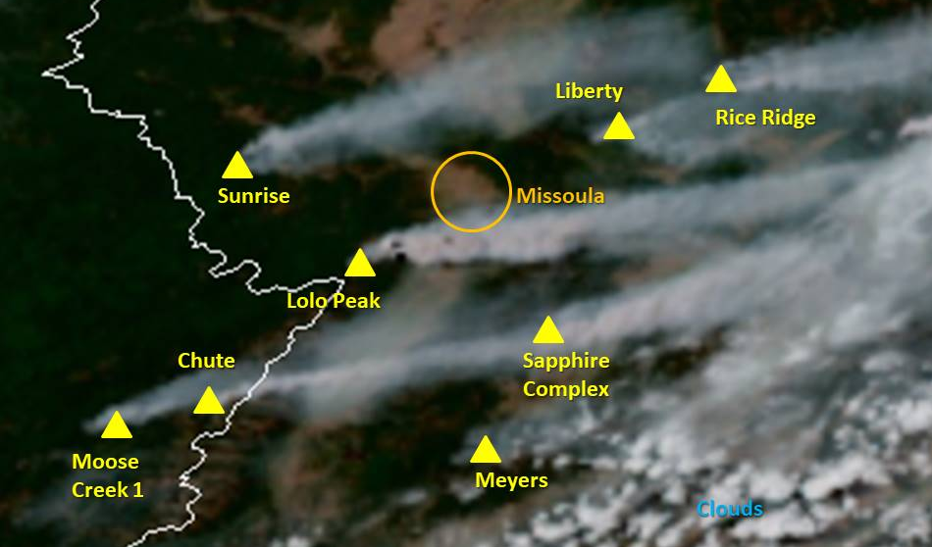
Public health messaging for wildfire smoke
Current air quality conditions
Where the smoke is coming from
Fire activity
Smoke behavior
How conditions will (or won’t) change during the day
Where to find cleaner air
How to stay protected from the smoke

Slide 9
Call to leave Seeley Lake
Recommending an entire community (even a small one) leave the area for smoke turned out to be a nonstarter. It would be even more difficult for larger communities

Slide 10
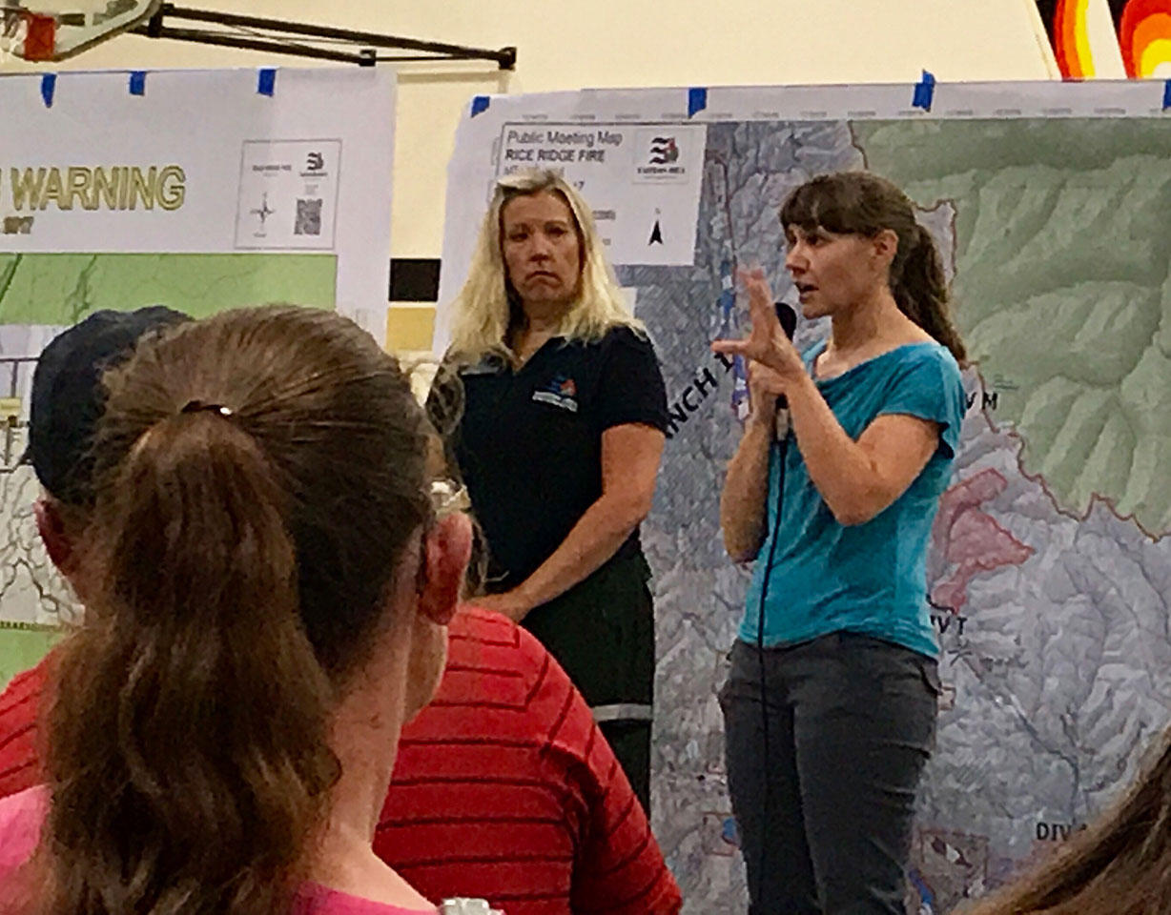
Public meetings
Air quality staff attended community meetings to explain MCCHD’s recommendations, answer questions about the smoke
Attending meetings may not have as much impact in larger communities - lower percentage in attendance and less word of mouth

Slide 11
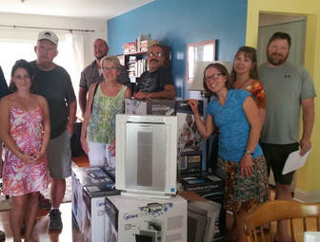
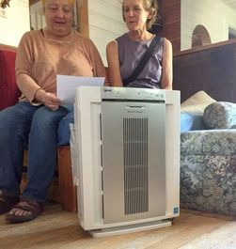
A public/private partnership born out of a shared desire to protect the public from wildfire smoke led to a smoke-ready pilot project in 2017. The project provided HEPA PACs to home-bound seniors with respiratory challenges and families with new babies. The project ballooned in response heavy wildfire smoke to include clinic patients and small elementary schools.
Intern Terri with volunteers from Lion's Den Ministries - getting ready to deliver filters.
A happy air cleaner recipient!

Slide 12
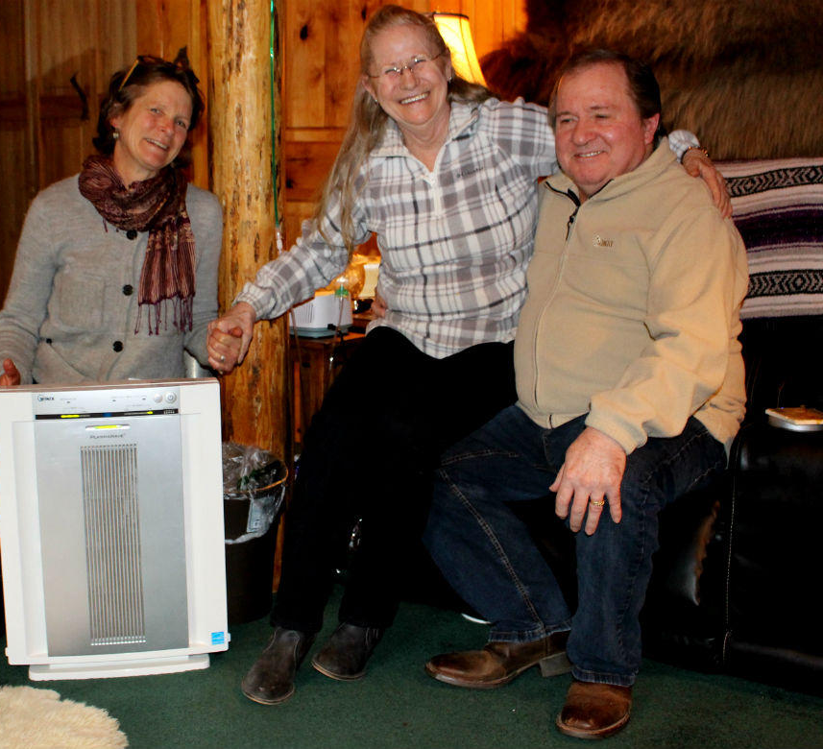
Helping Individuals
Climate Smart Missoula donated 25 portable air cleaners (PACs) to Seeley Lake health clinic patients and 5 PACs to the clinic itself.
“I believe that machine saved my life, I really do.”
-Don Dunagan, Seeley Lake resident
Photo and quote: “Summer of Smoke Exposes Need For Clean Indoor Air In Montana,” Nora Saks, Montana Public Radio, 1/3/18

Slide 13
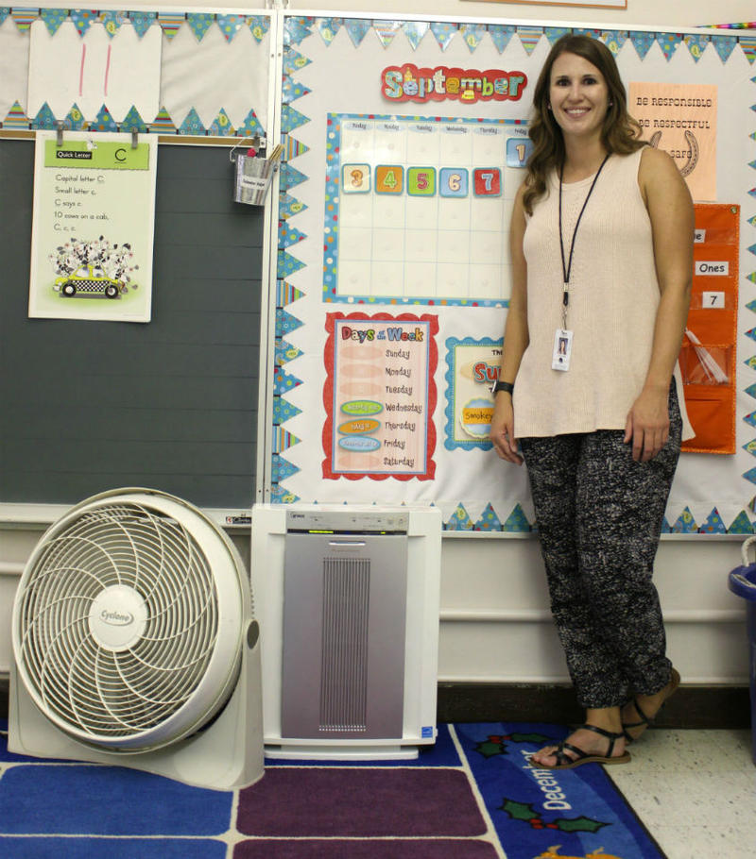
Helping schools
Elementary school classrooms in the hardest hit areas received PACs from MCCHD, CSM and other nonprofits.
157 filters in schools = ~$20,000
It would take ~$150,000 to buy PACs for the remaining Missoula County public school classrooms with MERV 8 or less filtration

Slide 14
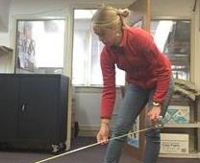
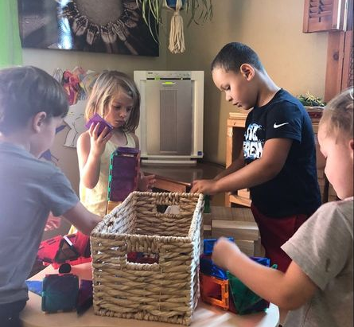
2018 Smoke-Ready Efforts in Missoula County
Clean air for daycares and preschools
Smoke-ready blog posts on MCCHD’s website
Recurring smoke-ready column in the Missoulian
Climate Smart Missoula’s new wildfire smoke website: www.montanawildfiresmoke.org
CSM measuring classroom square footage to determine number of PACs needed to provide clean air
PAC in a local preschool

Slide 15
Ongoing Efforts for MCCHD and CSM
Continue to purchase portable air cleaners (PACs) with HEPA filtration to grow our cache and prepare for the next wildfire season.
Prepare a wildfire smoke adaptation/mitigation plan for the county
Continue encouraging folks to seek out PACs before the smoke arrives.
Continue working with schools and public buildings that are under construction to encourage the use of wildfire smoke-ready filtration systems.
Climate Smart Missoula received funding from United Way of Missoula County to create a community needs assessment. The assessment describes the current ventilation systems in public schools and proposes options and strategies for providing clean air to students. Our next goal is to describe the ventilation systems in indoor athletic and fitness facilities.
MCCHD is working on a state legislation to commission a study that will hopefully lead to the creation of a bill or policy for smoke-adapted communities in Montana

Slide 16
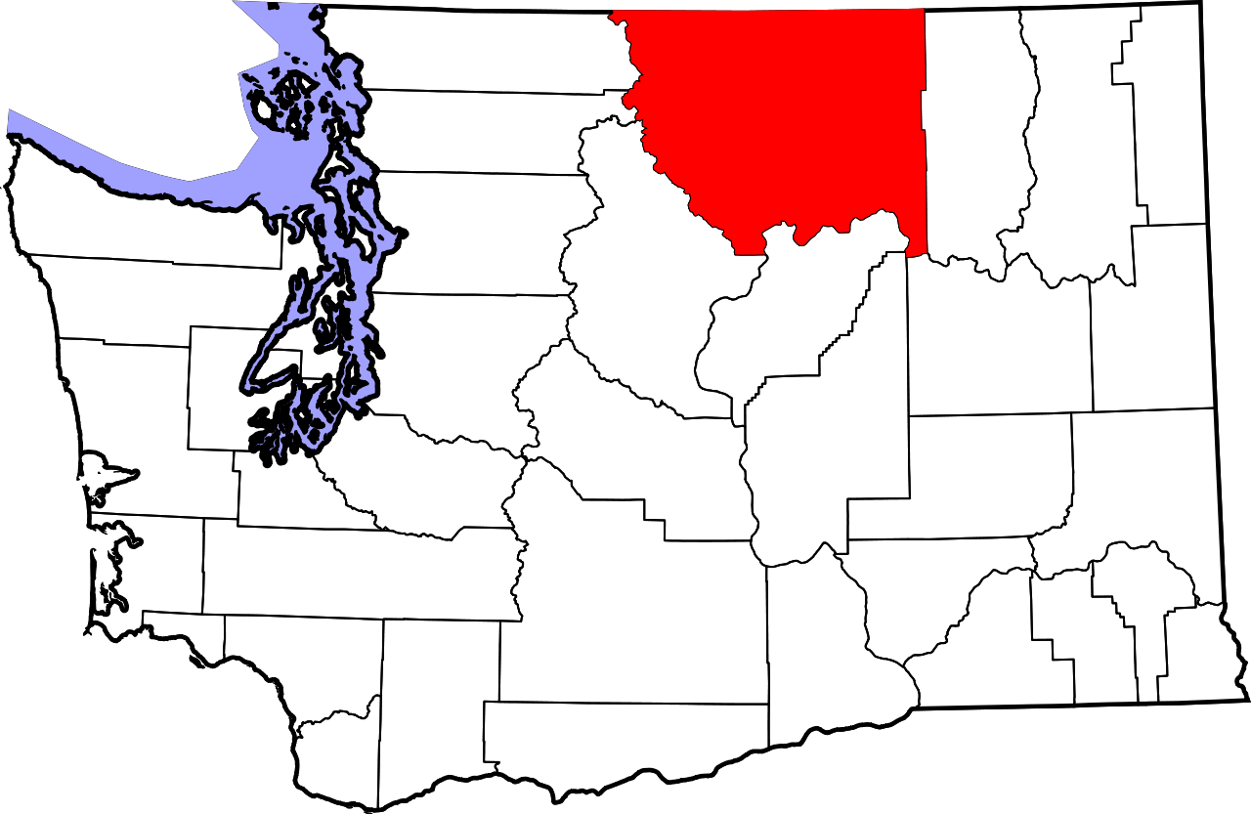
Wildfire Smoke Response in Okanogan County
Colville Reservation
Methow Valley

Slide 17
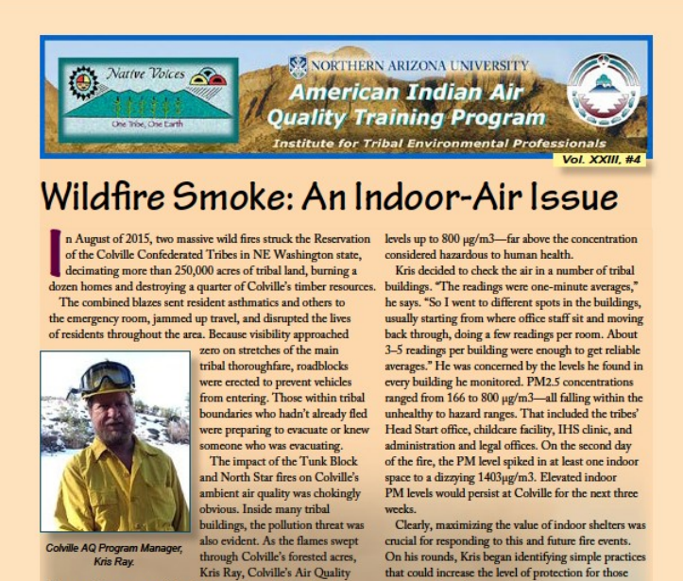
Colville Tribe
2015: 40 PACs to residents (FEMA grant)
Indoor air monitoring showed significant levels of wildfire smoke inside buildings
AQ Program manager partnered with Emergency Services and health workers during heavy smoke to assist vulnerable residents
Health and air staff plan to produce smoke-ready communities guidance for what to do before, during and after a fire
Website: https://www.cct-enr.com/smoke/

Slide 18
Methow Valley, WA
Methow Valley Clean Air Project
Partnering with UW in a grant application to create a wildfire smoke public health action plan specifically applicable to small, rural communities
Created a low-cost sensor network and “Clean Air Ambassador Program” of 22 purple air monitors spanning a 60 mile populated watershed placed with individuals, schools, towns, and businesses.
Coordinating with Okanogan River Airshed Partnership on smoke-ready workshops
Limited resources from local health department/emergency response
Health and emergency response agencies are receptive to the need for action, but they’re not willing/able to take leadership roles

Slide 19
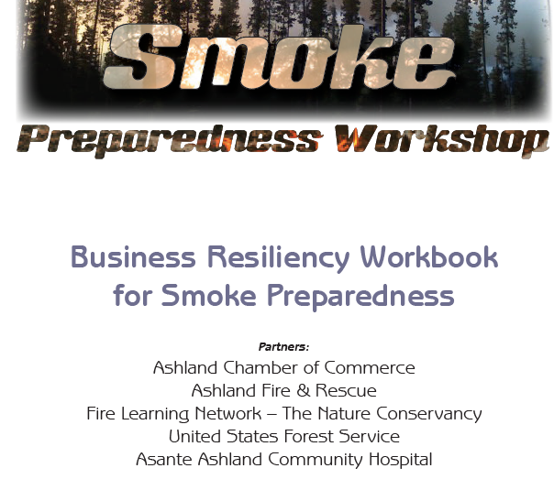
Ashland, Oregon – SmokeWise Ashland
Business resiliency workshop for smoke preparedness
Outreach materials in English and Spanish
Website: smokewiseashland.org
Multiple local partnerships – government, business and medical
Upcoming: Cleaner air program for businesses, clean air spaces for Ashland public schools, continued work with community partners, updated outreach materials
Notes:
Important to outreach to organizations that manage

Slide 20
Oregon Wildfire Response Protocol for Severe Smoke Episodes
Developed in response to recent wildfire seasons
Provides a cohesive wildfire smoke message for local health departments to share with their communities = support for smaller communities without the resources to create their own messaging
Recommends local community clean air shelters when air quality becomes very unhealthy or worse – unclear how that would work in small communities/who would be responsible for setting up and funding a shelter

Slide 21
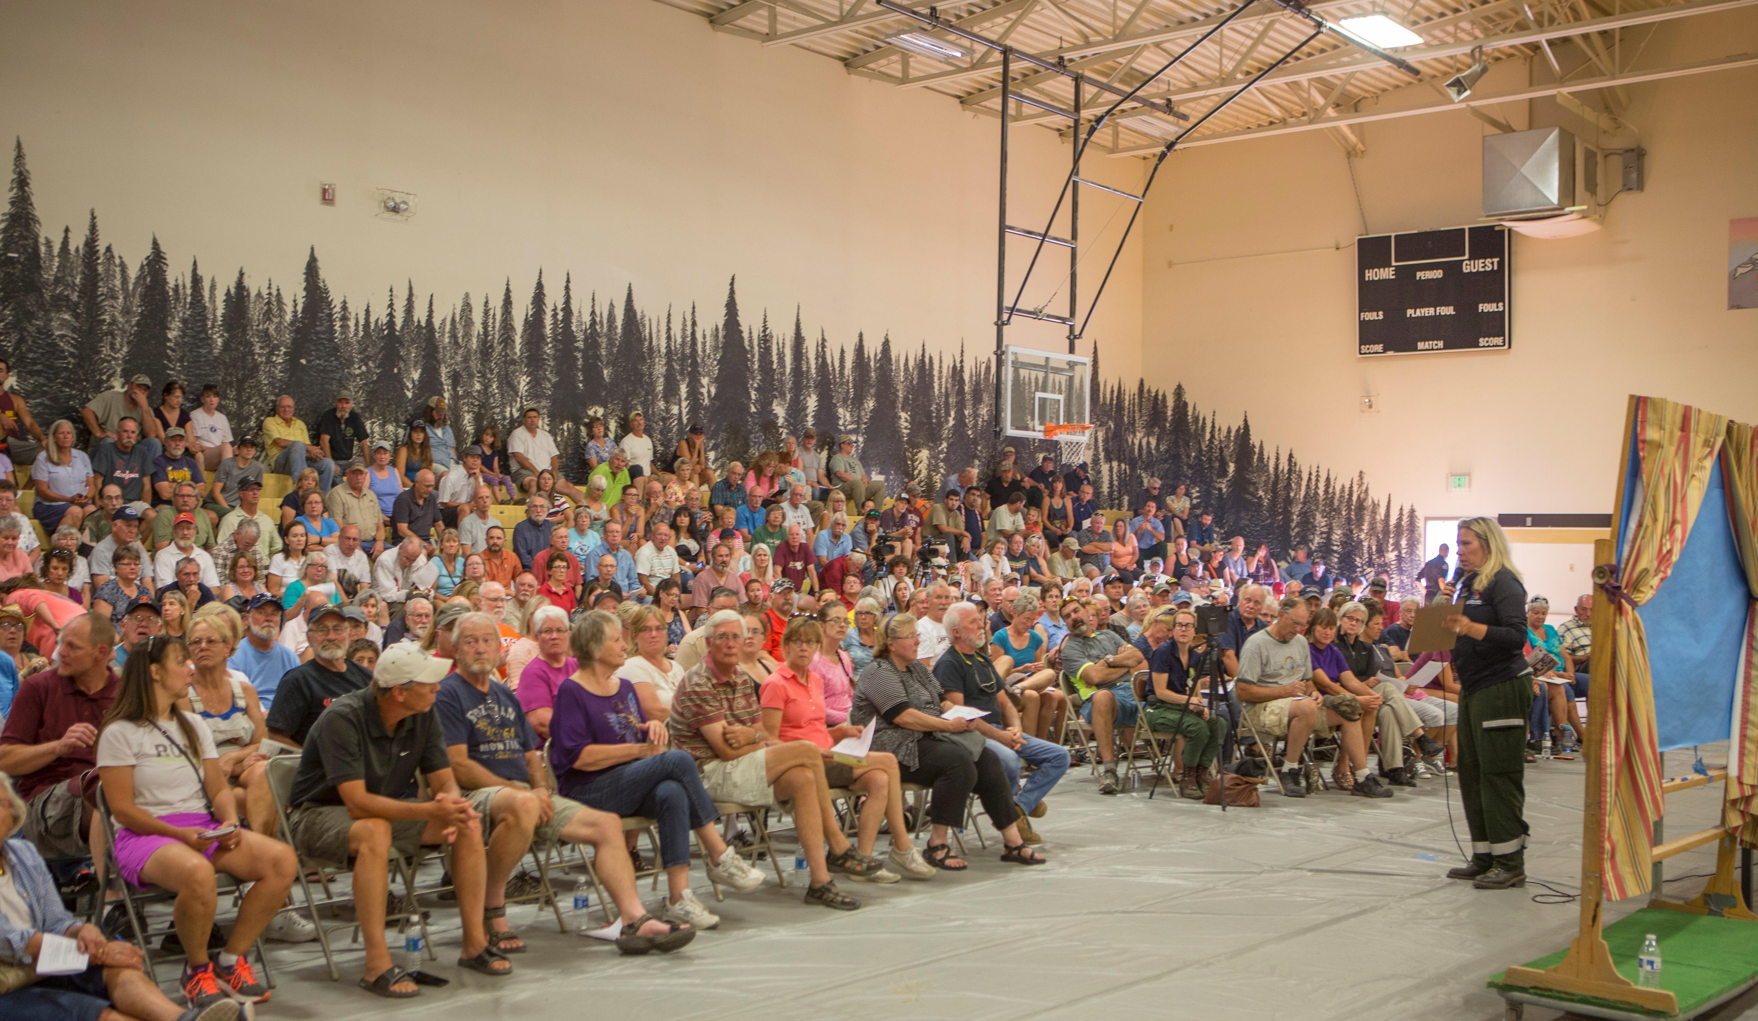
Communities of all sizes share certain traits
Everyone breathes the same air
Everyone needs information about risks from smoke and how they can protect themselves
There will be vulnerable/sensitive individuals
There will be people who need extra help
Rice Ridge Fire community meeting in Seeley Lake, MT

Slide 22
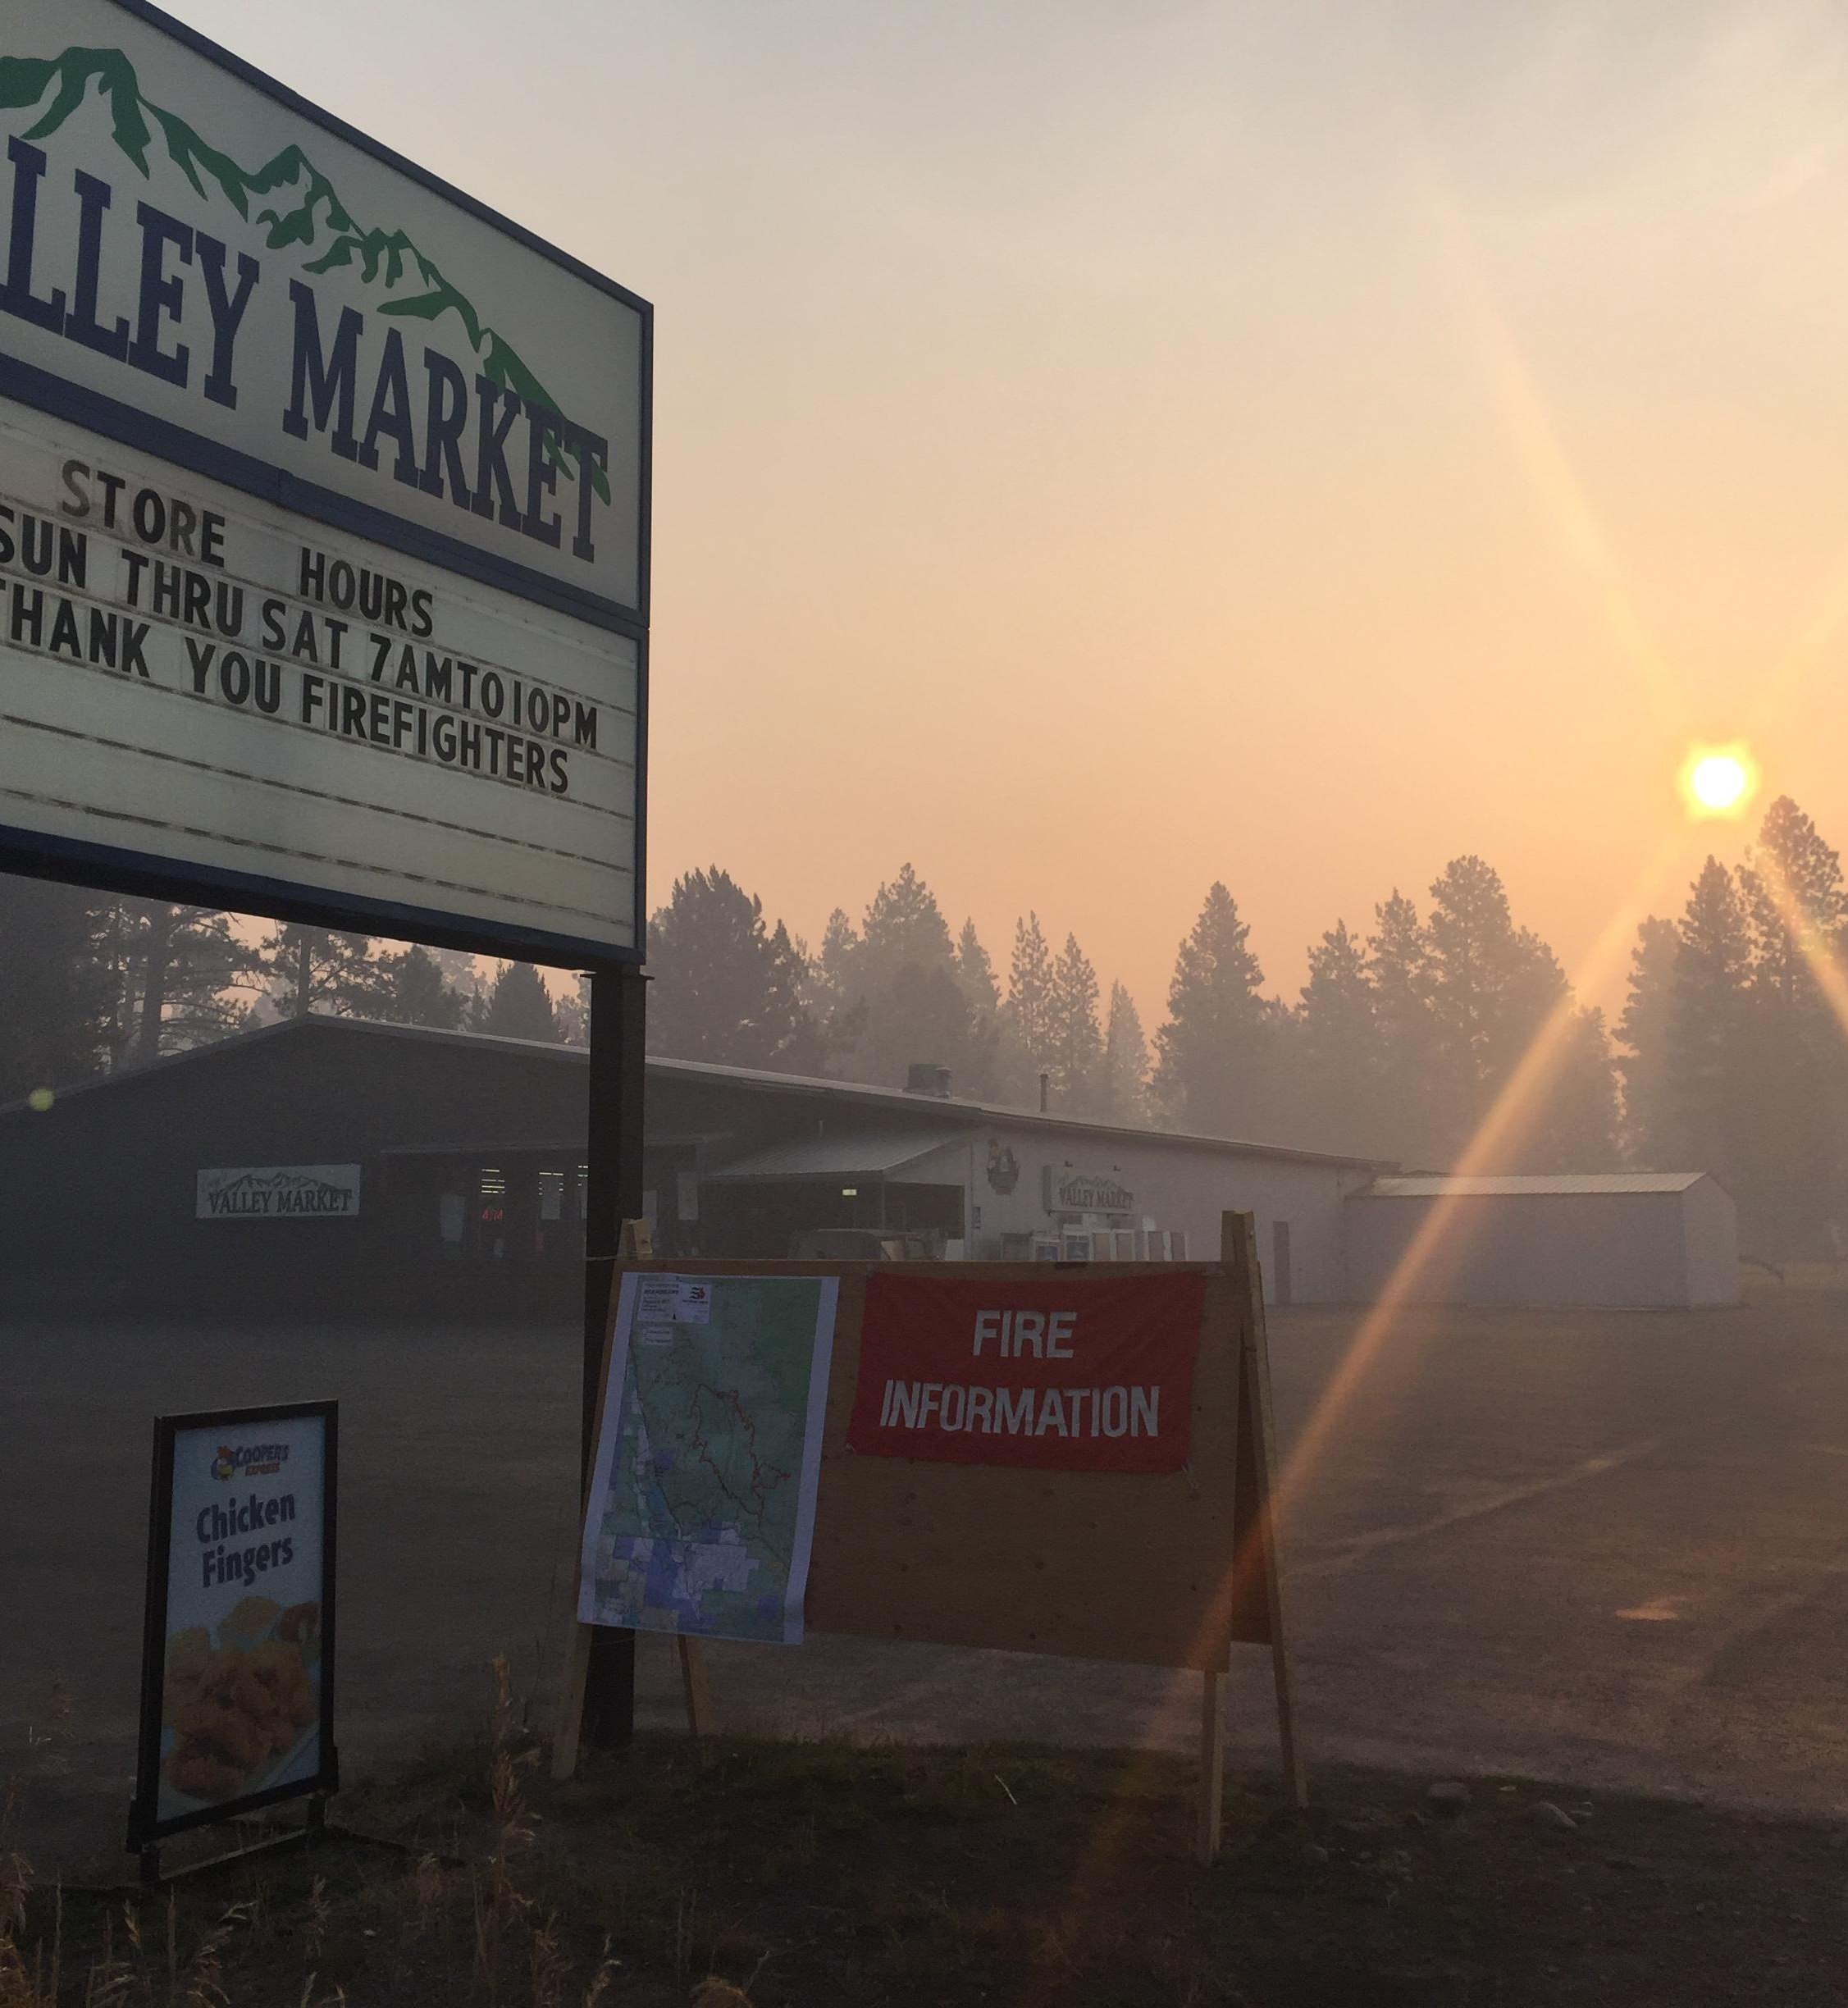
Challenges in small communities
Harder to get attention (i.e. funding or support) drawn to your area
Fewer resources and less expertise on-hand
When smoke response falls on health department staff, the emergency preparedness coordinator may be a public health nurse with little wildfire smoke experience.
Communities are unlikely to have a smoke response plan in their disaster and emergency mitigation plans.
Less likely to have air quality monitoring
56 counties in Montana; 15 counties have permanent PM2.5 monitors
Heavier reliance on state/regional smoke messaging and support, and that messaging may not make it to its audience

Slide 23
Opportunities in small communities
Fewer facilities housing vulnerable populations will make direct facility-level (schools, clinics, etc.) interventions more manageable
With smaller populations, direct interventions for highly vulnerable individuals may be more manageable
Closer knit communities help each other
Community meetings grab a larger swath of the population
Word of mouth can be an effective messaging tool - community members will spread messages and generosity

Slide 24
As community size grows (or as resources shrink):
The need for institutional/policy/engineering controls also grows
The need for individuals’ self-sufficiency grows

Slide 25
Help small communities become self-sufficient
Find trusted community leaders and build networks
Work in culturally appropriate ways.
Encourage community members to create clean indoor air spaces at home and give specific instruction on how to do this.
Provide ideas for creating community clean air spaces, as well as programming (e.g. movies, open play time for families, musical concerts) to combat anxiety and social isolation, as well as opportunity for information dissemination.
Encourage low cost solutions
Provide low-cost indoor air monitors (and training on appropriate use)
Encourage indoor air monitoring
Build cultural shift towards protecting health and building true resiliency to wildfire smoke

Slide 26
Potential partners
Nonprofits
Chamber of Commerce
Charitable foundations
Local hospitals
State and federal agencies

Slide 27
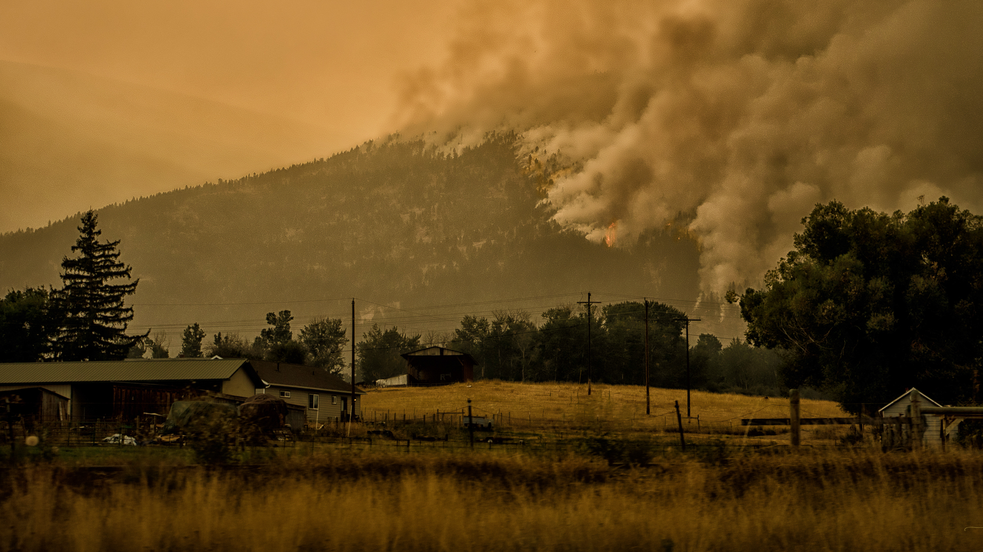
Take home:
Find a way to get relevant smoke preparedness and health advisory information to the community. News broadcasts from larger towns and health department Facebook posts probably aren’t going to cut it.
Small communities will be culturally different - this can be a strength, but can also make messaging more of a challenge
Plan ahead. Plan ahead. Plan ahead.
Figure out how you’re going to answer the mask questions.
Even when they’re the right response, evacuations for smoke probably aren’t the best response
If you choose direct interventions, prepare to triage recipients
Create partnerships with other organizations

Slide 28
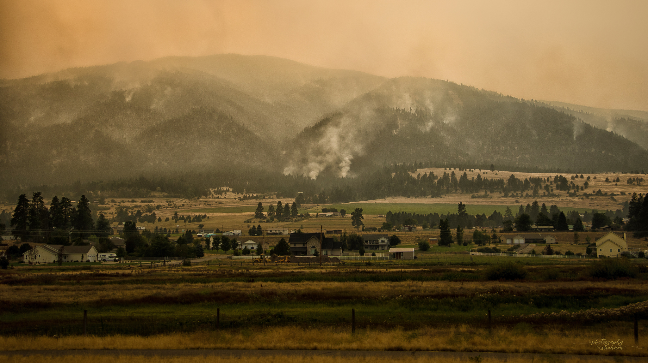
Questions?
Sarah Coefield
Air Quality Specialist
MCCHD
scoefield@missoulacounty.us
(406) 258-3642

